Slide 1

Vaccine wastage, vial size and session frequency
Paul Colrain
Technet, 18th October 2017, Cascais, Portugal
Notes:
iSC system design optimization = use sophisticated simulation software to maximize a, p, e, as function of iSC parameters
This presentation: use simple maths to understand how the choices of vial size & session frequency affect wastage rates, and …

Slide 2
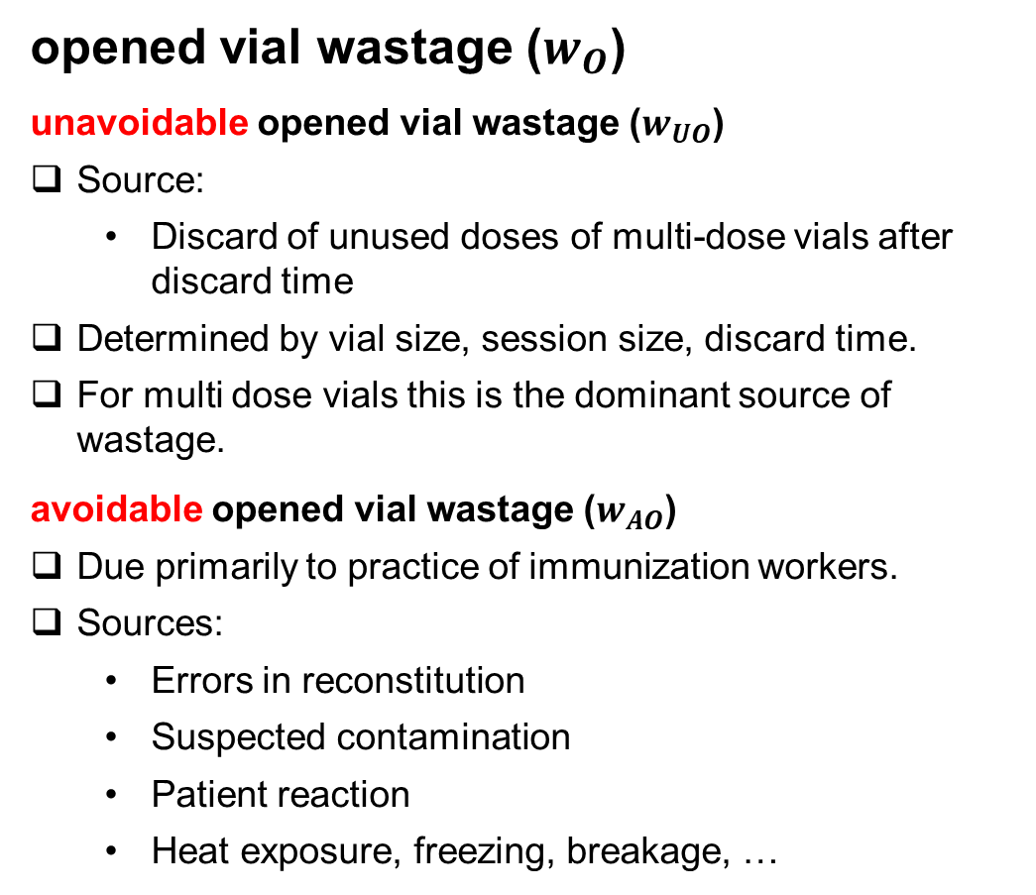
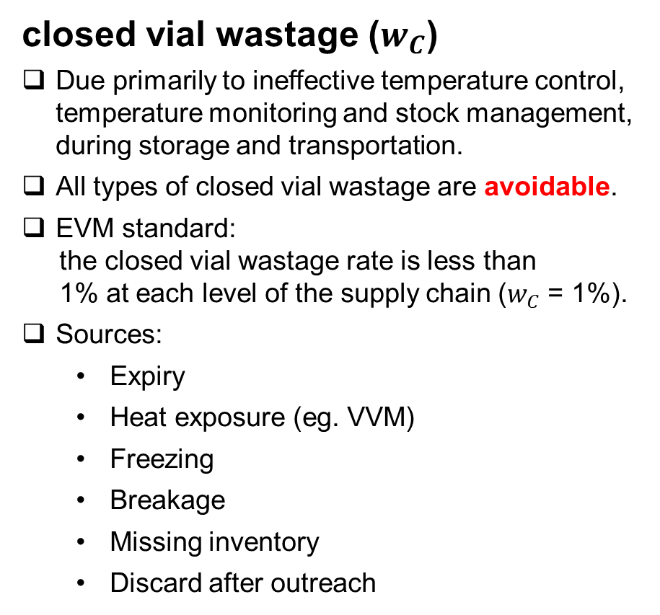
Types of vaccine wastage
closed vial wastage ($w_{C}$)
Due primarily to ineffective temperature control, temperature monitoring and stock management, during storage and transportation.
All types of closed vial wastage are avoidable.
EVM standard:
the closed vial wastage rate is less than
1% at each level of the supply chain ($w_{C}$ = 1%).
Sources:
  Expiry
  Heat exposure (eg. VVM)
  Freezing
  Breakage
  Missing inventory
  Discard after outreach
opened vial wastage ($w_{O}$)
unavoidable opened vial wastage ($w_{UO}$)
Source:
  Discard of unused doses of multi-dose vials after discard time
Determined by vial size, session size, discard time.
For multi dose vials this is the dominant source of wastage.
avoidable opened vial wastage ($w_{AO}$)
Due primarily to practice of immunization workers.
Sources:
  Errors in reconstitution
  Suspected contamination
  Patient reaction
  Heat exposure, freezing, breakage, …
Notes:
Unavoidable! And dominant!

Slide 3
The model
The model is 2 assumptions:
  A1 births are uniformly randomly distributed throughout the year
  A2 there is no day-of-week preference (2 or more sessions per week)
⇒ each dose has an equal probability of being administered in each session
That is it!
Everything that follows, follows logically from these 2 simple assumptions.

Slide 4
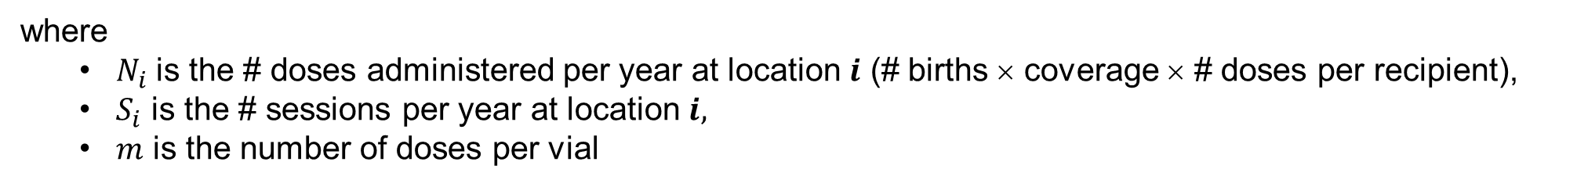
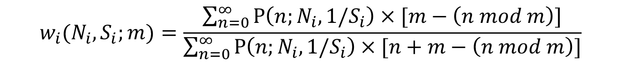
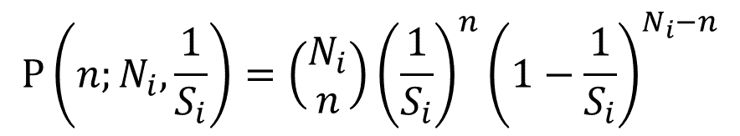
The maths
The probability of administering $n$ doses in a session at location $i$
$$P\left(n;N_{i},\frac{1}{S_{i}}\right)=\left(\begin{matrix}N_{i} \\ n\end{matrix}\right){\left(\frac{1}{S_{i}}\right)}^{n}{\left(1−\frac{1}{S_{i}}\right)}^{N_{i}−n}$$
where
  $N_{i}$ is the # doses administered per year at location $i$ (# births × coverage × # doses per recipient),
  $S_{i}$ is the # sessions per year at location $i$.
The expected opened vial wastage rate ($w_{i}$) of location $i$
$$w_{i}(N_{i},S_{i};m)=\frac{\sum_{n=0}^{∞}{P\left(n;N_{i}, 1/S_{i}\right)×[m−\left(n mod m\right)]}}{\sum_{n=0}^{∞}{P\left(n;N_{i}, 1/S_{i}\right)×[n+m−\left(n mod m\right)]}}$$
where
  $N_{i}$ is the # doses administered per year at location $i$ (# births × coverage × # doses per recipient),
  $S_{i}$ is the # sessions per year at location $i,$
  $m$ is the number of doses per vial

Slide 5
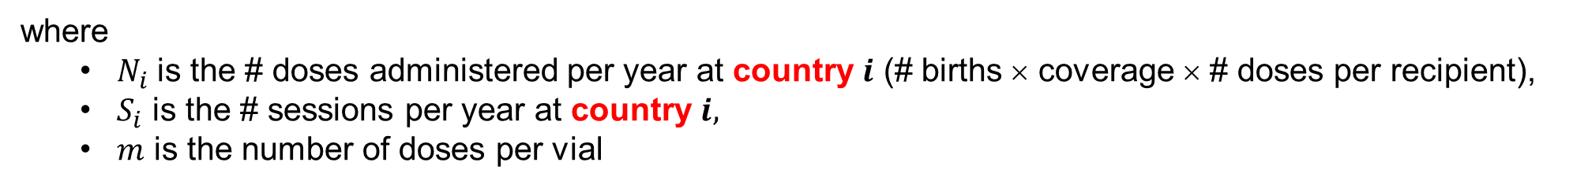
The maths
The probability of administering $n$ doses in a session in country $i$
$$P\left(n;N_{i},\frac{1}{S_{i}}\right)=\left(\begin{matrix}N_{i} \\ n\end{matrix}\right){\left(\frac{1}{S_{i}}\right)}^{n}{\left(1−\frac{1}{S_{i}}\right)}^{N_{i}−n}$$
where
  $N_{i}$ is the # doses administered per year at country $i$ (# births × coverage × # doses per recipient),
  $S_{i}$ is the # sessions per year at country $i$.
The expected opened vial wastage rate ($w_{i}$) of country $i$
$$w_{i}(N_{i},S_{i};m)=\frac{\sum_{n=0}^{∞}{P\left(n;N_{i}, 1/S_{i}\right)×[m−\left(n mod m\right)]}}{\sum_{n=0}^{∞}{P\left(n;N_{i}, 1/S_{i}\right)×[n+m−\left(n mod m\right)]}}$$
where
  $N_{i}$ is the # doses administered per year at country $i$ (# births × coverage × # doses per recipient),
  $S_{i}$ is the # sessions per year at country $i,$
  $m$ is the number of doses per vial

Slide 6
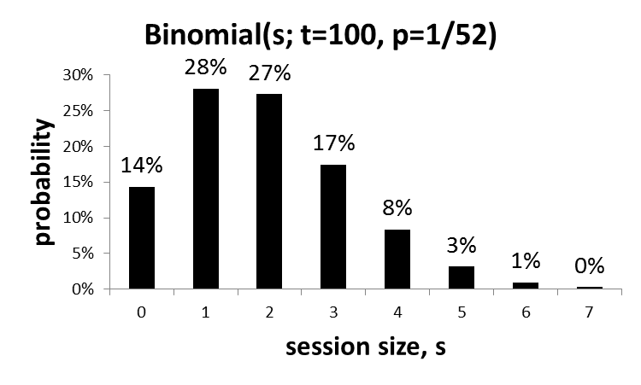
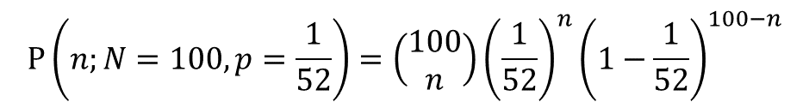
Session size probability distribution, an illustrative example
A health facility holds one Measles immunization session per week (52 per year), and
100 doses are administered in one year.
Q. What is the probability that any given dose is administered in the 12th session?
A. P(12th session) = 1/52 ≅ 2%
Q. What is the probability that 3 of the 100 doses are administered in the 12th session?
A. P(3 doses in 12th session) = P(n = 3; N = 100, p = 1/52) = 17%
$$P\left(n;N=100,p=\frac{1}{52}\right)=\left(\begin{matrix}100 \\ n\end{matrix}\right){\left(\frac{1}{52}\right)}^{n}{\left(1−\frac{1}{52}\right)}^{100−n}$$
Key condition:
Each dose has an equal probability of being administered in each session.
n
*Number of doses administered in one year = annual birth rate × number of doses per infant × coverage.
Notes:
This is the key slide. Given # doses and # sessions we know the probability distribution, assuming A1 and A2.
Each realization of this scenario will yield a statistical variation of this distribution, but this is the expected distribution.

Slide 7
Model versus data: Bangladesh, DTP, 10 dose vial
In 2004 the Darajhat facility in Bangladesh administered 418 doses of DTP Vaccine.
The facility held 94 immunization sessions that year.
MEAN SESSION SIZE = # DOSES / # SESSIONS = 418 / 94 = 4.4
Based on the hypothesis that the session size distribution is Binomial(n; N=418, p=1/94), the expected session size distribution may be generated…
Notes:
When comparing, the mean of binomial is set by mean of empirical, so expect means to be same. What we are looking for is the shape (single-peaked, bell-shaped) and the spread/width.
Explain that we are looking at the data not to see if theory is sound (if assumptions hold, sessions ARE binomial), but to see for how many facilities the assumptions are sound – the assumption that kids are immunized according to schedule or as close as possible)
Superimpose theory – Wow!

Slide 8
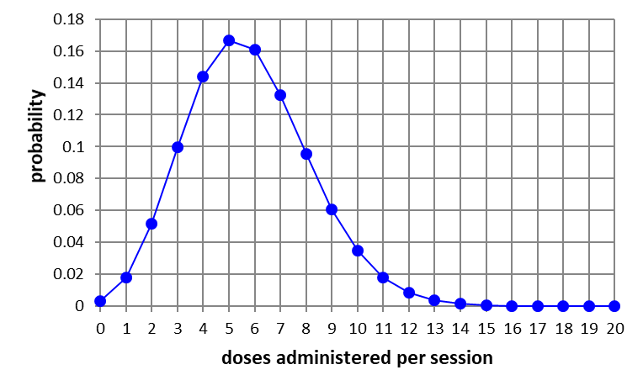
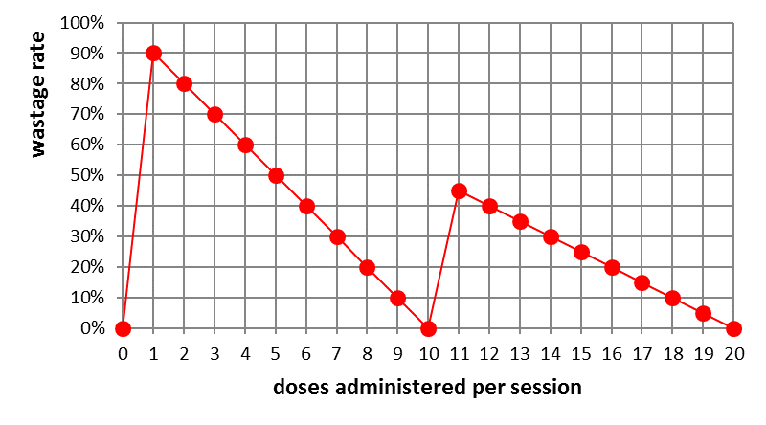

Expected opened vial wastage rate, an illustrative example
Births per year = 250
Doses per recipient = 3
Target coverage = 80%
Doses administered per year = 600
Sessions per week = 2
⇒ Mean session size = 600/104 = 5.8
Doses per vial = 10
Discard time = 6 hours
Expected wastage rate = 44%
Notes:
If you don’t believe this, you are now in small minority.

Slide 9
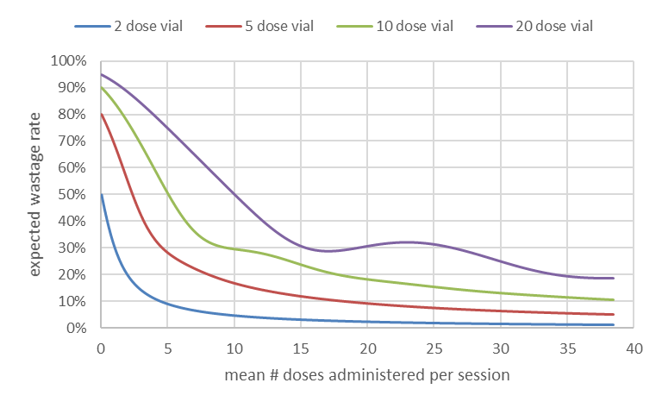
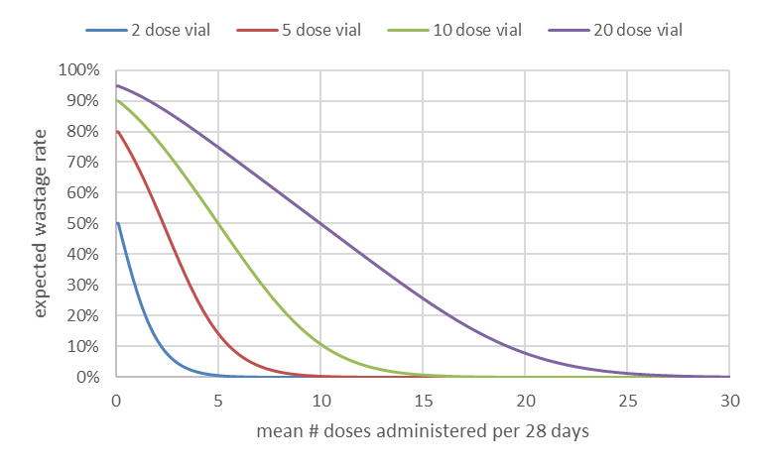
Expected wastage rate
discard after 6 hours discard after 28 days
Notes:
If you don’t believe this, you are now in small minority.

Slide 10
Expected wastage rate lookup tables
Notes:
Inorporate the lokkup tables into LMIS solutions, to facilitate immunization planning, needs forecasting and wastage monitoring.

Slide 11
Model versus data
Single Binomial !
The Single Binomial estimate:
within 5% of the data points for 95% of the locations, and,
always within 10%.
Notes:
The data points are the Bangladesh 10 dose vial opened vial wastage rates.
The red line shows the current WHO indicative 10 dose vial opened vial wastage rate of 40%. It looks about right on average, but is far from the actual values for most facilities.
The curve shows the expected opened vial wastage rates, assuming A1 and A2 hold. That is, assuming that each session size distribution is described by a single Binomial.
The data points are expected to deviate slightly from the curve due to statistical fluctuation, but also because a single Binomial does not accurately reflect the session distributions of some immunization locations.
Despite this, the single Binomial estimate is within 5% of the data points for 95% of immunization locations, and is always within 10%.
Note that the largest deviations ocurr just below and above the vial size of 10. Inspection of each individual data point shows that these deviations are due to violation of A2.

Slide 12
Implications
Inform choice of vial size and session frequency
Accurately forecast needs
Monitor wastage rates against expected values, not against zero

Slide 13
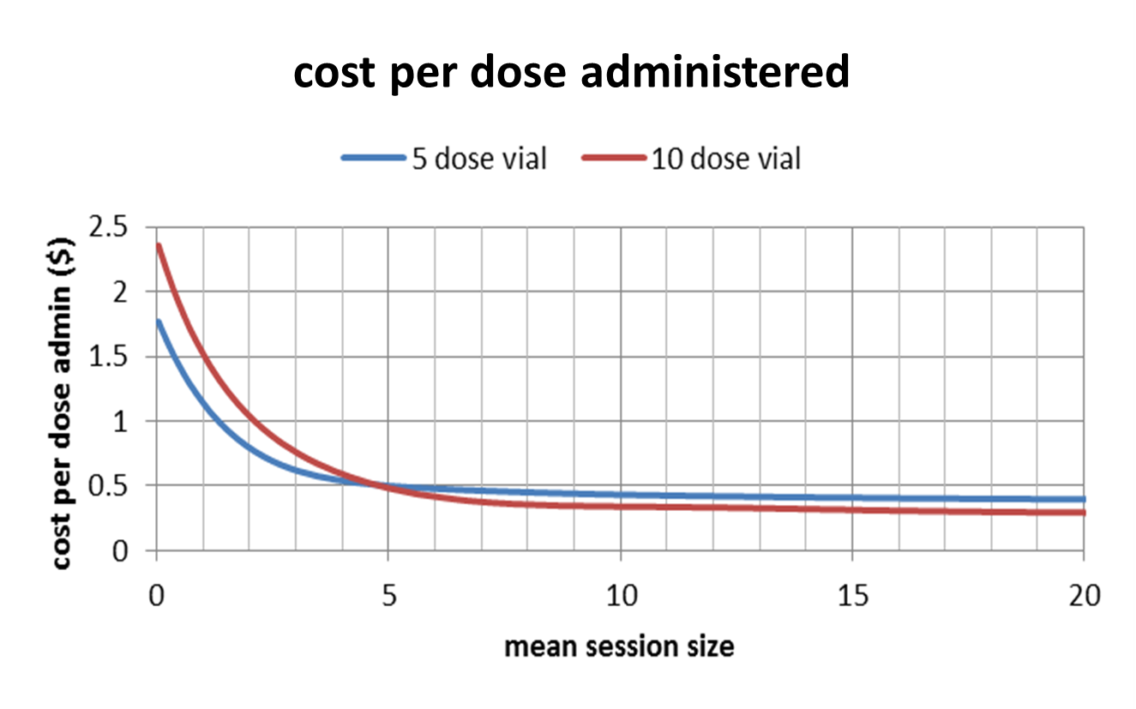
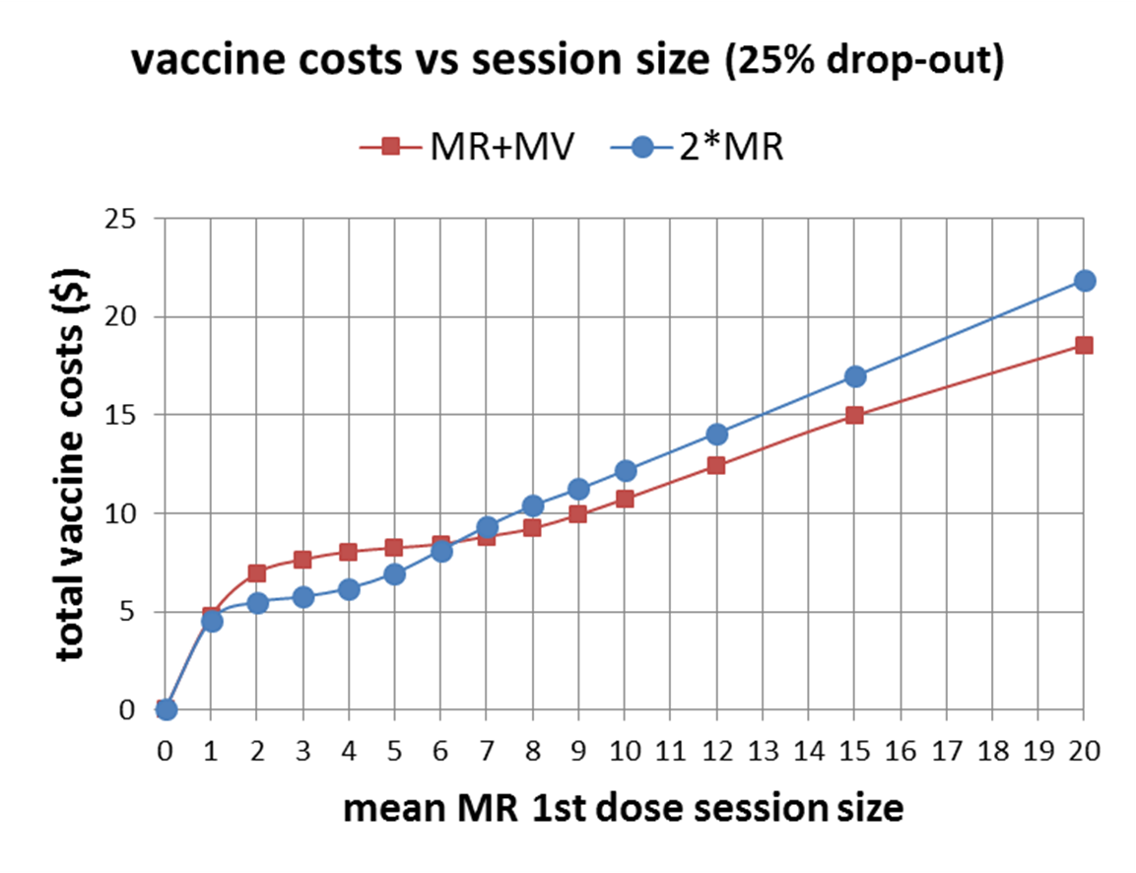
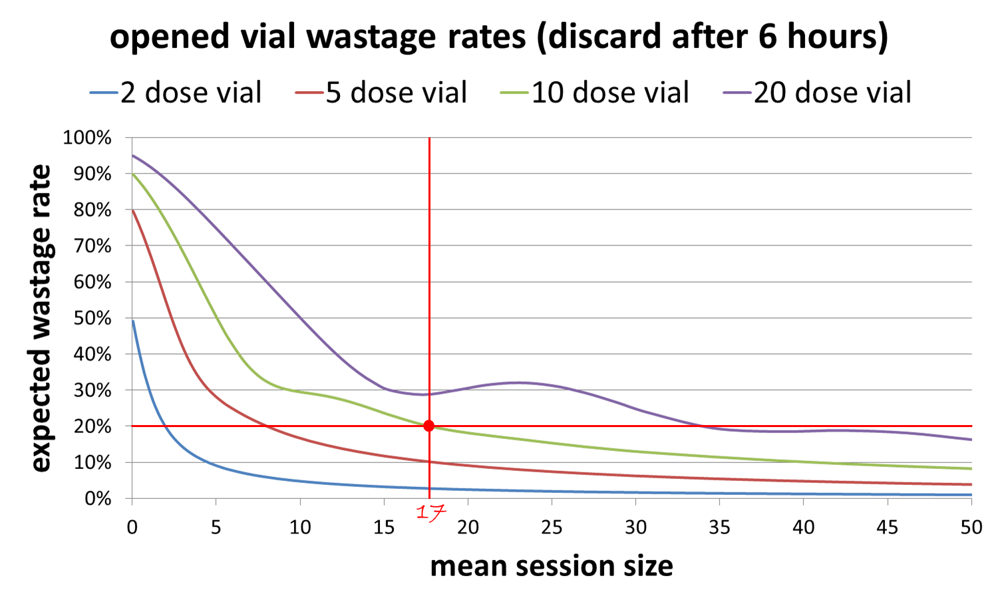
Implications
Inform choice of vial size and session frequency
Accurately forecast needs
Monitor wastage rates against expected values, not against zero

Slide 14
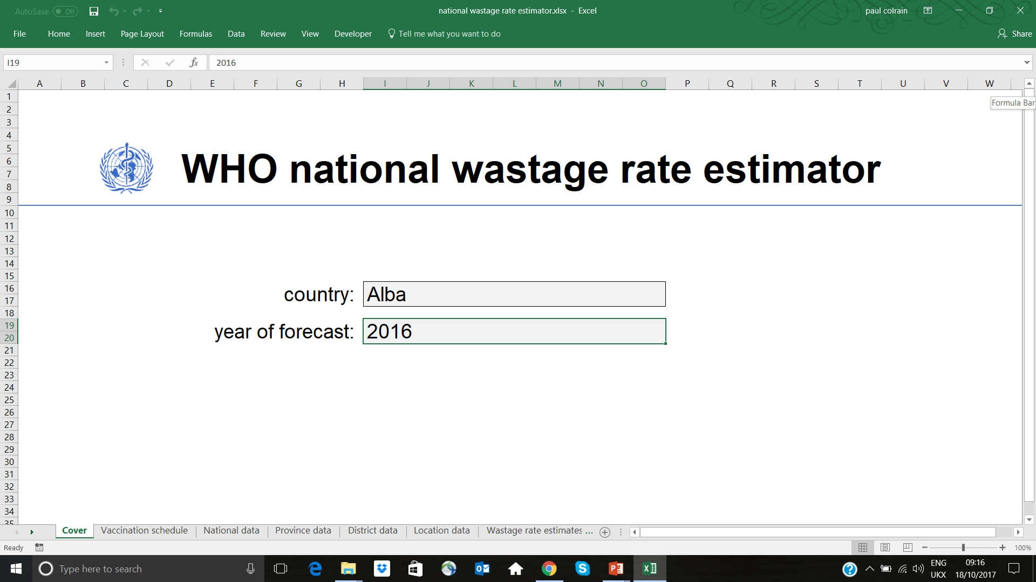
Implications
Inform choice of vial size and session frequency
Accurately forecast needs
Monitor wastage rates against expected values, not against zero

Slide 15
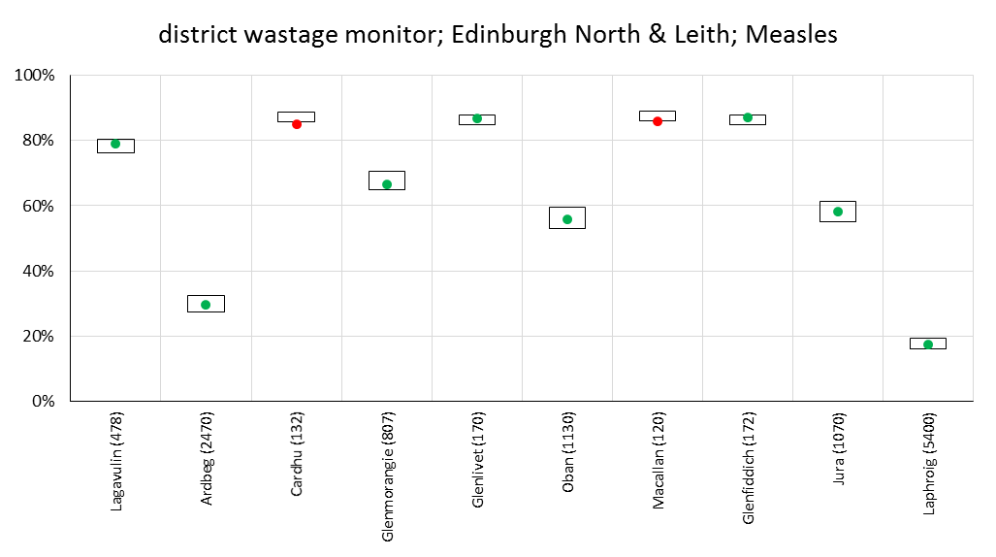
Implications
Inform choice of vial size and session frequency
Accurately forecast needs
Monitor wastage rates against expected values, not against zero

Slide 16
Thank you
Notes:
Good afternoon everyone.
I hope to answer some of the questions from yesterday’s optimal vialsize session, those related to opened vial wastage, using nothing other than mathematical logic.
Specifically, I hope to convince you that given only the # births and the # sessions per week, we know the opened vial wastage rate for each vial size and policy.
No programmatic implications, no closed vial wastage, …

Slide 17
Back-up
Notes:
Good afternoon everyone.
I hope to answer some of the questions from yesterday’s optimal vialsize session, those related to opened vial wastage, using nothing other than mathematical logic.
Specifically, I hope to convince you that given only the # births and the # sessions per week, we know the opened vial wastage rate for each vial size and policy.
No programmatic implications, no closed vial wastage, …

Slide 18
National Wastage Rate Estimator

Slide 19
national wastage rate estimator – proposed method
In the absence of reliable empirical data, WHO proposes that the national wastage rate be estimated as:
$$1−{\left(1−w_{C}\right)}^{n}×(1−w_{UO})×(1−w_{AO})$$
set by EVM to 1% per storage level
estimated using the Binomial logic and country specific program data (below)
set to 1%
national opened vial wastage rate estimator
The expected # births and the expected # sessions are determined for each immunization location, fixed and outreach.
The Binomial logic is used to determine the expected opened vial wastage rate for each location.
The wastage rates of all locations are aggregated to give the national wastage rate estimate.
Notes:
Until now

Slide 20
national opened vial wastage rate estimate
The expected opened vial wastage rate ($w_{i}$) of location $i$
$$w_{i}(N_{i},S_{i};m)=\frac{\sum_{n=0}^{∞}{P\left(n;N_{i}, 1/S_{i}\right)×[m−\left(n mod m\right)]}}{\sum_{n=0}^{∞}{P\left(n;N_{i}, 1/S_{i}\right)×[n+m−\left(n mod m\right)]}}$$
where
  $N_{i}$ is the # doses administered per year at location $i$ (# births × coverage × # doses per recipient),
  $S_{i}$ is the # sessions per year at location $i$.
The expected opened vial wastage rate ($w$) of a nation*
$$w=\frac{\sum_{i}{w_{i}×\frac{N_{i}}{1−w_{i}}}}{\sum_{i}{\frac{N_{i}}{1−w_{i}}}}$$
*The wastage rate of each location is weighted with the location’s consumption (# doses consumed).
⇒ all we need is # births and # sessions for all locations!

Slide 21
simulation
The district level estimator makes 4 assumptions in each district:
  all fixed locations in the district have the same population (the mean),
  all fixed locations in the district have the same number of sessions per week (the mode),
  all outreach locations in the district have the same population (the mean),
  all outreach locations in the district have the same number of sessions per week (the mode).
The same assumptions are made at the province/national level by the province/national level estimators.
The independent country of Alba has heterogeneity of province, district and location sizes and session frequencies:
  10,000,000 population, 400,000 births
  10 provinces (32%, 16%, 16%, 8%, 8%, 4%, 4%, 4%, 4%, 4%)
  10 districts in each (32%, 16%, 16%, 8%, 8%, 4%, 4%, 4%, 4%, 4%)
  10 locations in each district (32%, 16%, 16%, 8%, 8%, 4%, 4%, 4%, 4%, 4%) ⇒ heterogeneity of location sizes per district, province, nationally.
  the largest 50% of locations nationally are fixed sites
    the largest 30% have 5 sessions per week, the 20% have 2 ⇒ heterogeneity of fixed site session frequencies per district, province, …
  the smallest 50% of locations nationally are outreach sites
    the largest 35% have 1 session per week, the 15% have 1 per month ⇒ heterogeneity of outreach session frequencies per district, …
⇒ the 4 assumptions are all broken in Alba, badly broken!
⇒ if the district, province and national level estimators perform well in Alba, they should perform well in all countries!

Slide 22
performance of estimators
A simple Excel tool has been developed to demonstrate how the methodology could be implemented.
This tool has been populated with the Alba data to see how the national wastage rate estimators perform.

Slide 23
National wastage rate estimator – a formula + a lookup table
$w=1−{\left(1−w_{C}\right)}^{n}×\left(1−w_{UO}\right)×\left(1−w_{AO}\right)$
$$w_{UO}=f(mean session size;vial size)$$
$w=1−{\left(1−0.01\right)}^{n}×\left(1−w_{UO}\right)×\left(1−0.01\right)$
Example: Caledonia
  annual birth rate of 236,000
  4 supply chain levels ($n$ = 4)
  113 fixed sites, no outreach
  almost all sites are open Monday to Friday (260 sessions)
  ∼100% coverage for all vaccines
Question:
What is the national wastage rate for Measles in Caledonia?
(10 dose vial, discard after 6 hours, 1 dose per child)
Answer:
Expected number of doses administered per year = 236,000
Mean-mean session size = 236,000/(113*260) = 8.03 ⇒ $w_{UO}$ ∼ 32%
$ w=1−{\left(1−0.01\right)}^{4}×\left(1−0.32\right)×\left(1−0.01\right)$
$$w=35\%$$

Slide 24
National wastage rate estimator – IT solution
In a country with significant heterogeneity of session frequencies across provinces, districts or types of service delivery, it would be prudent to conduct the above exercise at a lower level, the province or district level, where the level of heterogeneity may be less within each unit.
Ideally, the exercise should be conducted for each immunization location, fixed site and outreach.
Software may facilitate the exercise of estimating the wastage rate for the chosen unit (location, district, province) and aggregating to the national level.

Slide 25

wastage factor
forecast = cohort size × coverage × number of doses per recipient × wastage factor
$$wastage factor=\frac{1}{(1−wastage rate)}$$
wastage rate | wastage factor
10% | 1.11
20% | 1.25
30% | 1.43
40% | 1.67
50% | 2
60% | 2.5
70% | 3.33
80% | 5
90% | 10
95% | 20
⇒ for large wastage rates, a small error in the wastage rate results in a large error in the forecast.

Slide 26
Combining wastage rates of different days
discard after 6 hours
Consider the following scenario:
5 dose vial, 2 sessions per week
Monday sessions:
  260 doses administered in 52 sessions
  ⇒ mean session size = 5 ⇒ expected wastage rate = 28%
  ⇒ 101.1 doses wasted and 361.1 doses consumed
Friday sessions:
  780 doses administered in 52 sessions
  mean session size = 15 ⇒ wastage rate = 12%
  106.4 doses wasted and 886.4 doses consumed
Combined wastage rate for Monday and Friday:
  = (101.1+106.4)/(361.1+886.4) = 207.5/1247.5 = 16.6%
What does the lookup table say if weekly aggregate figures are used?
1040 doses administered in 104 sessions
  ⇒ mean session size = 10 ⇒ wastage rate = 16.7%
⇒ Day preference averages out!
Notes:
If you don’t believe this, you are now in small minority.

Slide 27
Combining wastage rates of different facilities
discard after 6 hours
Consider the following scenario:
20 dose vial
A small district with 2 facilities:
  Facility A
    520 doses administered in 104 sessions (2 sessions per week)
    mean session size = 5 ⇒ wastage rate = 75%
    1560.0 doses wasted and 2080.0 doses consumed
  Facility B
    780 doses administered in 52 sessions (1 session per week)
    mean session size = 15 ⇒ wastage rate = 31%
    350.4 doses wasted and 1130.4 doses consumed
Combined wastage rate for the district:
  = (1560.0+350.4)/(2080.0+1130.4) = 1910.4/3210.4 = 59%
What does the lookup table/chart give us if we use district aggregate figures?
1300 doses administered in 156 sessions
  ⇒ mean session size = 8.3 ⇒ wastage rate = 58%
⇒ We can use the lookup tables for districts & even countries, not just individual locations!
Notes:
If you don’t believe this, you are now in small minority.

